Slide 1
How to Write a Good MSc Thesis
George Fletcher and Mykola Pechenizkiy
2ID95 WE Seminar
8 January 2014
TU Eindhoven, the Netherlands

Slide 2
Outline
Examples of different kinds of projects/thesis
A summary on different research methods
Why should someone write a good thesis?
What is typically expected?
A typical timeline of master projects
Possible thesis structure
Good/bad practices
Ideally your seminar project is a small-scale master project and your report is a small-scale master thesis (but depends on the starting point and kind of the project)

Slide 3
MSc project Planning
6 months project
  Check the examination committee date you are aiming for
  Count two weeks back – deadline for your final presentation
  Count two more weeks back – deadline for your submit your master thesis to the assessment committee
  Intermediate presentation ~ half way
Plan ahead

Slide 4
Collaboration spirit
Update regularly, e.g. a few sentence summary of what you achieved during a week, and what your plan for the coming week is.
Committing to SVN every day or using a Dropbox is a good and natural way to keep track of your progress.
If something goes wrong – just tell about it to your advisor: “No shame , no blame” - policy
Value time of your advisor
Listen carefully to comments on your work and writing
  Ask for a clarification if you are not sure you got it right
  When you get speciﬁc comments – think if you can generalize, understand the spirit of the comments rather than literally correcting and change your text at other places where that kind of problem occurs.

Slide 5
Academic/scientific research
There are different (often evolving) opinions on:
Science vs. research vs. engineering
Basic research
Theoretical
Conceptual-theoretical
Experimental
Design science
R&D
How research should be validated
Methods vary a lot from one field to the other, but research question should be aligned with a right research method and evaluation methodology. When you make statements of what has been achieved, check the alignment of the above once more.
Notes:
Many of you worry and ask about the academic/scientific component of your work
In SWE: http://www.cs.cmu.edu/~Compose/ftp/shaw-fin-etaps.pdf; http://www.cs.toronto.edu/~sme/CSC2130/index.html
Design science and IS (especially Scandinavian school – see below)

Slide 6
A multimethodological approach to the construction of an IS
Theory Building
IS
Development
Observation
Experimentation
Adapted from: Nunamaker, W., Chen, M., and Purdin, T. 1990-91, Systems development in information systems research, Journal of Management Information Systems, 7(3), 89-106.
Notes:
5

Slide 7
IS R&D Framework
Environment
Relevance
IS Research
Rigor
Knowledge
Base
People
F
oundations
Roles
Develop/Build
Base
-
level t
heories
Capabilities
Theories
Frameworks
Characteristics
Artifacts
Knowledge
Models
Instantiation
Organizations
Business
Validation Criteria
Strategy
Assess
Refine
Structure&Culture
Design knowledge
Processes
Justify/
Methodologies
Evaluate
Validation Criteria
Technology
Needs
Applicable
(not instantiations
Infrastructure
Analytical
of models
but
KDD
Applications
Case Study
processes, services,
Com
munications
Experimental
systems)
Architecture
Field Study
Development
Simulation
Capabilities
(Un
-
)Successful Applications in
Contribution to Knowledge Base
the appropriate
environment
Adapted from Hevner et al. Design Science in Information Systems Research, MIS Quarterly, 26(1), 2004, 75-105.
Notes:
6

Slide 8
The Action Research and Design Science Approach to IS R&D
Awareness of business problem
Contextual
Knowledge
Action planning
Business
Knowledge
Design
Knowledge
Artifact Development
Artifact Evaluation
Action taking
Conclusion
Notes:
7

Slide 9
IS facet
Ives B., Hamilton S., Davis G. (1980). “A Framework for Research in Computer-based MIS” Management Science, 26(9), 910-934.
Notes:
8

Slide 10
IS Success Model
System
Quality
Use
Individual
Impact
Information
Quality
User
Satisfaction
Service
Quality
Organizational
Impact
Notes:
9

Slide 11
How we subjectively classify projects
By contribution?
New technique, approach, framework, architecture, theory:
Theoretical
  Building theory, analytical, stating theorems and proving them
Design/engineering project – not to be confused/mixed with the practical goals of a (software) internship
Experimental/Empirical
  Possibly including or mainly focusing on case study, field study
  Efficient/parallel etc. implementations
  Benchmarking state of the art techniques
Multi-disciplinary
Notes:
What is science? A short working definintion: systematically working hard on a problem, in an open and honest fashion.
Systematically ensuring that your are honest (to yourself).
Systematic and verifiable/falsifiable.

Slide 12
How we subjectively classify projects
For example, in a “theoretical” project
  Identify problem
    Determine assumptions
    Define relevant basic concepts
    Define the problem in terms of (a) and (b)
  Identify what is known about the problem
  Propose solution(s) to the problem
  Give analytic (and also possibly empirical) characterizations of your solution(s)
Note that the process is often very similar for conceptual and experimental projects …

Slide 13
How we subjectively classify projects
For example, in an “experimental” project
  Benchmarking approach
    Empirically verify solution(s) on a set of recognized (or a proposed) benchmark, with clear criteria of success (e.g., efficiency, effectiveness, cost)
  Case-study approach
    Collect what is known in a problem domain, in a systematic, unbiased and objective manner
    Can serve as a validation of solutions or as a systematic exploration of a problem space
      Think of the job of an anthropologist
  Hybrid of both …

Slide 14
Questions to think about any project
What are you trying to do? Articulate your objectives using absolutely no jargon. Can you say it in 1-2 sentences?
How is it done today, and what are the limits of current practice?
Who cares? If successful, what difference will it make?
What’s new in your approach and why do you think it will be successful?
What are the risks and the payoffs?
How much will it cost? How long will it take?
What are the midterm and final “exams” to check for success?
Notes:
Some attributed to George Heilmeier, see e.g. http://jbdeaton.com/2012/heilmeiers-catechism/

Slide 15
Questions (to ask yourself)
What are you most concerned/uncertain about with respect to your proposed project?
How do you see your project fitting into the paradigms we’ve discussed above?
Do you have clear metrics of success for your project?
  Or is this part of the process itself?
Does your project have a well defined scope?
  Or is this part of the process itself?

Slide 16
An example from previous 2ID95
Project of Erik Tromp, graduated Cum Laude
Had in mind “Multilingual Sentiment Analysis on Social Media” as a topic for master project
Decided to work on “Language Identification on Short Texts” as an assignment for the seminar. Came up with “Graph-Based N-gram Language Identification” approach and showed that it outperforms state-of-the-art approach for short texts.
As an outcome:
  input for a scientific paper – worked out for Benelearn submission, appeared among top 3 papers among accepted works;
  much of preparatory work done for the master project and a much better estimation of what can be done in the 6 months project work;
  a better understanding how to improve reporting skills and how much effort writing a good thesis may take

Slide 17
Another example from previous 2ID95
Project of Jelle Hellings, graduated Cum Laude, nominated for TU/e Final project award
Focus on algorithms and formal/empirical analysis:
  Bisimulation partitioning of massive (i.e., disk-resident) graphs
  Motivated by social network analysis, model checking, query processing, etc.
Outcomes
  First known I/O efficient solution
  Presentation of full paper at SIGMOD 2012
  PhD research position in the Database research group at University of Hasselt (BE)

Slide 18
Thesis writing

Slide 19
Is the thesis important at all?
Seriously affects your graduation project grade
  One of the 4 scores, but the main source to judge your work for the committee members
This is the main output of your life at TU/e – accessible to the rest of the world
  Unless you continue into academic research => this is the only academic report/thesis that will represent you for the rest of your life
It’s more fun if you can take pride in your work!

Slide 20
What is expected
What Makes a Good Research Problem?
It is important: If you can solve it, you can make money, or save lives, or help children learn a new language, or...
You can get real data: at least for data mining/information retrieval projects
You can make incremental progress: Some problems are all all-or or-nothing. Such problems may be too risky for young professionals.
There is a clear metric for success: how do you know that you’ve done a great job?

Slide 21
Simple rules of the games
Master Thesis – is your project, you are expected to take the lead and responsibility
Appreciate your supervisor’s time as a very limited resource
  Avoid a lame excuse “oh, I haven’t checked it for typos yet” and alike
  Do not distract your supervisor’s attention from the contents to trivial formal aspects (make the text, figures etc look good)
  No plagiarism
  Avoid blank statements – support with reasoning or references
  Show that you understand how the work is positions
It is not easy to make a good ﬁrst impression, and keep it until the very end of the project, but it is even more difficult to do so after making a bad first impression

Slide 22
Thesis writing
There are three rules for writing a good thesis:
… Unfortunately, no one knows what they are.
    Paraphrasing W. Somerset Maugham
    “There are three rules for writing a novel”

Slide 23
Thesis Writing
Thesis structure is likely to change in places a couple of times by the time the project work is finished
  Report the results, NOT the process
It is hardly possible to write a perfect thesis in one go (even for a professional writer who already produced or guided dozens of theses).

Slide 24
Thesis Writing
Accept that some text and results that you produce will be thrown away, some excluded because of lesser importance, some will move to appendixes.
You need your mediocre versions for turning them into better and better ones

Slide 25
Thesis Writing
Accept from the very beginning that you need to devote a lot of time and effort for writing and rewriting
Start early and do your writing on a continuous basis (do not separate writing into)
  Do you remember what you read 4 months ago?
  Can you remember how you pre-processed the data you used in your last project?

Slide 26
Thesis Writing
There are different opinions on completeness of the thesis. Thesis should be self-contained, but for different people this may mean different things depending on background, type of the project etc.
  1 committee member will be from outside WE
  Informal guideline: your fellow students should be able to understand your thesis
  In case of doubt, consult your advisor
Your text shouldn’t leave the reader with any open major questions
  i.e., the text should justify/motivate every (major) statement it makes
  “Don’t let the reader think” – do the thinking for them! This is your job as the writer.

Slide 27
Thesis Writing
Make a working title
Introduce the topic and define (informally at this stage) terminology
Motivation: Emphasize why is the topic important
Relate to current knowledge: what’s been done
Indicate the gap: what need’s to be done?
Formally pose research questions
Explain any necessary background material.
Introduce formal definitions.
Introduce your novel (or selected existing) algorithm/representation/data structure etc.
Describe experimental set-up, explain what the experiments will show (Reproducibility!)
Describe the datasets
Summarize results with figures/tables
Discuss results
Explain conflicting results, unexpected findings and discrepancies with other research
State limitations of the study
State importance of findings
Announce directions for further research
Write Acknowledgements
Check References for completeness, relevance, redundancy, coverage of topic in recent years, formatting

Slide 28
Example of possible thesis structure
1 Introduction
1.1 Motivation (business and research perspective)
1.2 Thesis objective and methodology
1.3 Results
1.4 Thesis structure
2 Background
2.1 Stakeholders in this project
2.2 Positioning of your project work
3 Problem formulation
3.1 Formal problem definition
3.2 Challenges
4 Solutions/approach/method
4.1 Related work
4.2 Our approach
5 Experimental study/case study
  5.1 Data 5.2 Experiment design 5.3 Results
6 Conclusions
6.1 Contribution 6.2 Limitations (acknowledge this weakness ) 6.3 Future work
References, Lists of appendixes, tables, figures, acronyms
Examples of good thesis reports: http://www.win.tue.nl/~mpechen/projects/pdfs/Tromp2011.pdf
http://www.win.tue.nl/~mpechen/projects/pdfs/Putman2010.pdf
http://www.win.tue.nl/~mpechen/projects/pdfs/Louvan2009.pdf
http://www.win.tue.nl/~mpechen/projects/pdfs/Budziak2008.pdf

Slide 29
Useful writing principles
The following slides are borrowed from the excellent lecture of Eamonn Keogh

Slide 30
Useful writing principle
Don’t make the reviewer of your paper think!
1) If they are forced to think, they may resent being forced to make the effort. The are literally not being paid to think.
2) If you let the reader think, they may think wrong!
With very careful writing, great organization, and self explaining figures, you can (and should) remove most of the effort for the reviewer

Slide 31
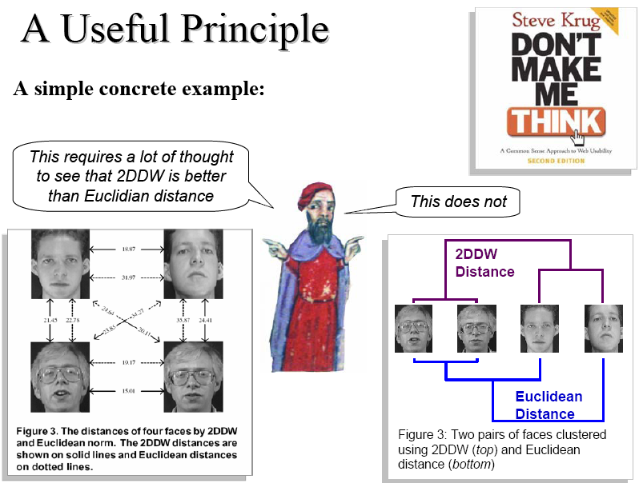

Slide 32
Anchoring
“Another strategy people seem to use intuitively and unconsciously to simplify the task of making judgments is called anchoring. Some natural starting point is used as a first approximation to the desired judgment.
This starting point is then adjusted, based on the results of additional information or analysis. Typically, however, the starting point serves as an anchor that reduces the amount of adjustment, so the final estimate remains closer to the starting point than it ought to be.”
Richards J. Heuer, Jr. Psychology of Intelligence Analysis (CIA)

Slide 33
Anchoring (by Jennifer Windom)
The introduction acts as an anchor. By the end of the introduction the reader must know:
  What is the problem?
  Why is it interesting and important?
  Why is it hard? why do naive approaches fail?
  Why hasn't it been solved before? (Or, what's wrong with previous proposed solutions?)
  What are the key components of my approach and results? Also include any specific limitations.
A final paragraph or subsection: “Summary of Contributions”. It should list:
  the major contributions in bullet form,
  mentioning in which sections they can be found.
This material doubles as an outline of the rest of the paper, saving space and eliminating redundancy.

Slide 34
Reproducibility
Reproducibility is one of the main principles of the scientific method, and refers to the ability of a test or experiment to be accurately reproduced, or replicated, by someone else working independently.
“The vast body of results being generated by current computational science practice suffer a large and growing credibility gap: it is impossible to believe most of the computational results shown in conferences and papers” David Donoho

Slide 35
How to Ensure Reproducibility
Explicitly state all parameters and settings in your paper.
Build a webpage with annotated data and code and point to it
Also, avoid having too many parameters and
  For every parameter in your method, you must show, by logic, reason or experiment, that either…There is some way to set a good value for the parameter.
  The exact value of the parameter makes little difference.

Slide 36
Avoid Unjustified Choices
Bad: We used single linkage clustering... Why?
Good: We experimented with single/group/complete linkage, but found this choice made little difference, we therefore report only single…
Better: We experimented with single/group/complete linkage, but found this choice little difference, we therefore report only single linkage in this paper, however the interested reader can view the Appendix X to see all variants of clustering.

Slide 37
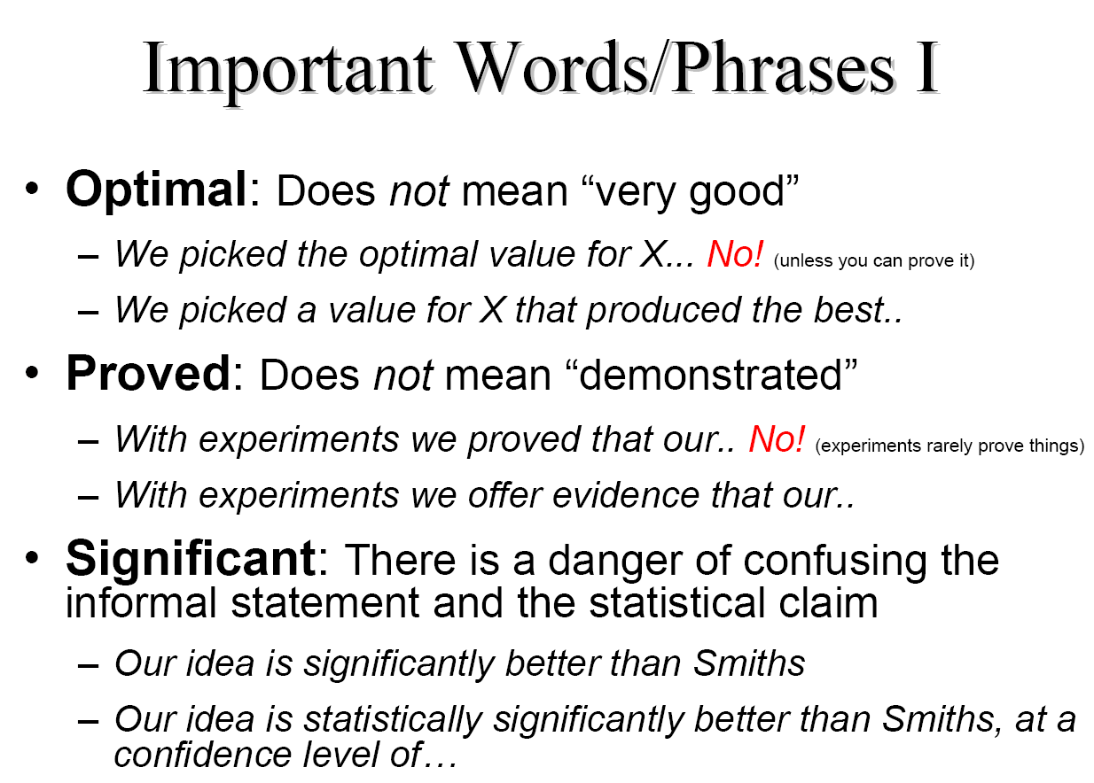

Slide 38
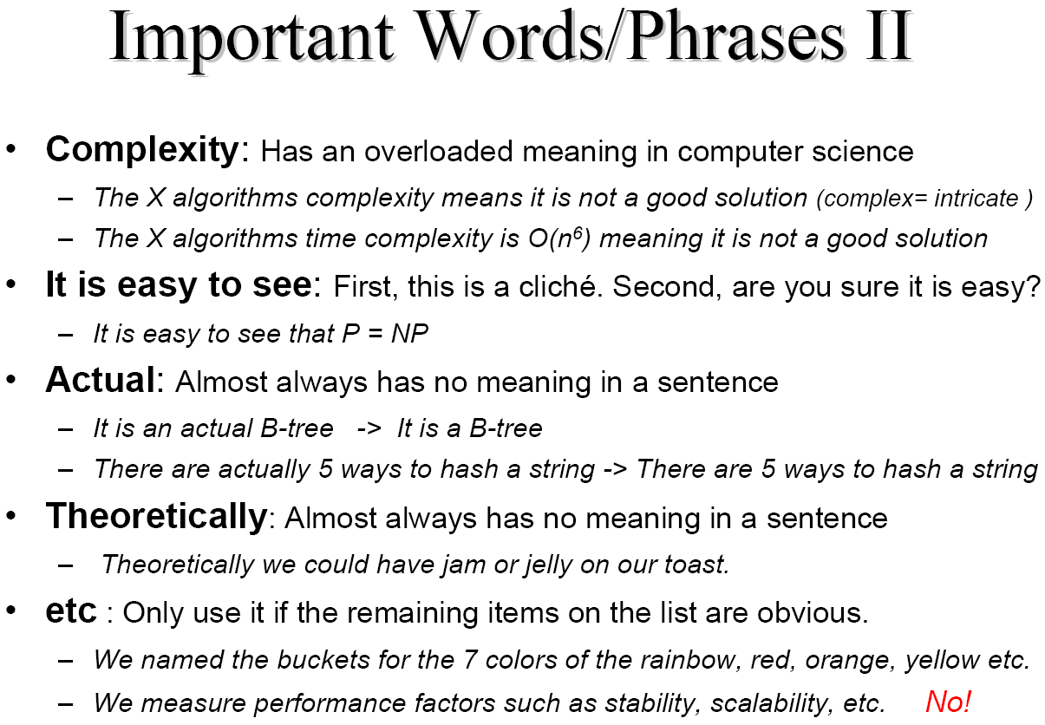

Slide 39
Try to be concise yet precise
Don’t say “We mined the data…”, if you can say “We clustered the data..” or “We classified the data…” etc
  Concise should not mean shallow
  Precise does not mean just filling pages
How large the thesis should be:
  50 pages of the main content
    Shorter is possible !!
    Longer thesis should be justified
  A typical journal paper is 20-30 pages
    Almost no master thesis has enough content for a conference paper, let it be a journal paper …

Slide 40
Thesis formatting
You can use a template xxx.tex
Use figures and simple examples to illustrate your ideas – they help to understand your work and to better organize it.
Remember to give meaningful captions to ﬁgures and tables; they must be referred to in the text.
Check that the resolution of the figures is good, e.g. use .pdf cropping instead of screenshort =>.png

Slide 41
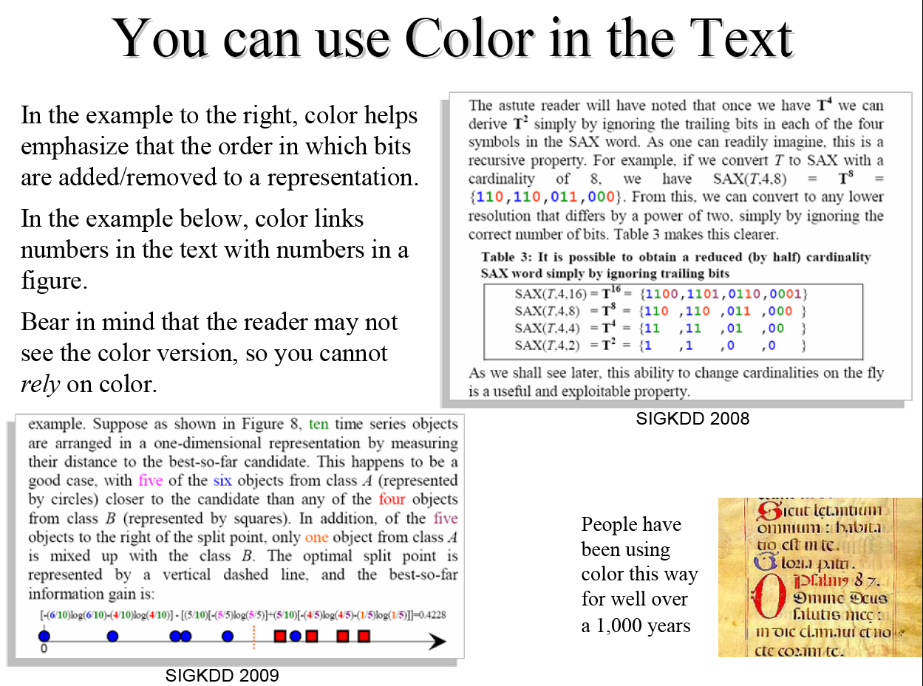

Slide 42
Style
Written vs. spoken
Academic vs. media/business report/tech report etc.
Avoid weak language: compare 3 ways of saying
  ..with a dynamic series, it might fail to give accurate results.
  ..with a dynamic series, it has been shown by [7] to give inaccurate results. (give a concrete reference)
  ..with a dynamic series, it will give inaccurate results, as we show in Section 7. (show me numbers)
Avoid overstating
  We have shown our algorithm is better than a decision tree.
  We have shown our algorithm can be better than decision trees, when the data is correlated.
  On Iris dataset, we showed that our algorithm is more accurate, in future work we plan to discover the conditions under which...
Use the Active Voice
Avoid nonreferential use of "this", "that", "these", "it”
Notes:
Compare
In this paper, we attempt to approximate and index a d-dimensional spatio-temporal trajectory..
With…
In this paper, we approximate and index a d- dimensional spatio-temporal trajectory..
Or…
In this paper, we show, for the first time, how to approximate and index a d-dimensional spatio- temporal trajectory..

Slide 43
Citing other work
You have to demonstrate that you can cite properly
Cite your sources; otherwise, you plagiarize
  i.e. do not present something as new and yours if it is someone else’s work
  Say explicitly “The following deﬁnition is taken verbatim from~\cite{x}.” if it is so.
  If you base an entire section on some other work - explain this once at the beginning
Any cited work must be referred to in the main text.
Cite those works that are relevant for your work, not everything that you have read.
Mandatory vs. helpful references – you need to assume that people know; if you are in doubt, ask your supervisor
Avoid citing lecture handouts, wikipedia, etc – prefer textbooks and research papers to these sources
Know what you cite, do not copy blindly citations from other works
The bibliography is one of the ﬁrst things a reader looks at. Expert – to check the context and what works are cited/omitted, novice – to find related/further reading.
After collecting the bibliographic details make sure they look consistent
Notes:
Mandatory: Give credit to the inventor
Helpful: Be effective; what is the best work, in your opinion, for someone to understand? => if established technique: very likely to be a textbooks rather than a conference paper

Slide 44
Literature: Pitfalls to avoid
Learn how to recognize a good venue (reputable journal, conference) and authors
Even in these cases there is not guarantee that everything you read is true.
The Importance of being Cynical
  We must be careful not to assume that it is not worth trying X, since X is “known” not to work, or Y is “known” to be better than X
Notes:
Cfr: data mining course; project = reproduce results of high quality publications → very often fails!
In one instance the claims that were “proven” by the experiments were totally wrong. (paper won the best research paper award at a reputable data mining conference)

Slide 45
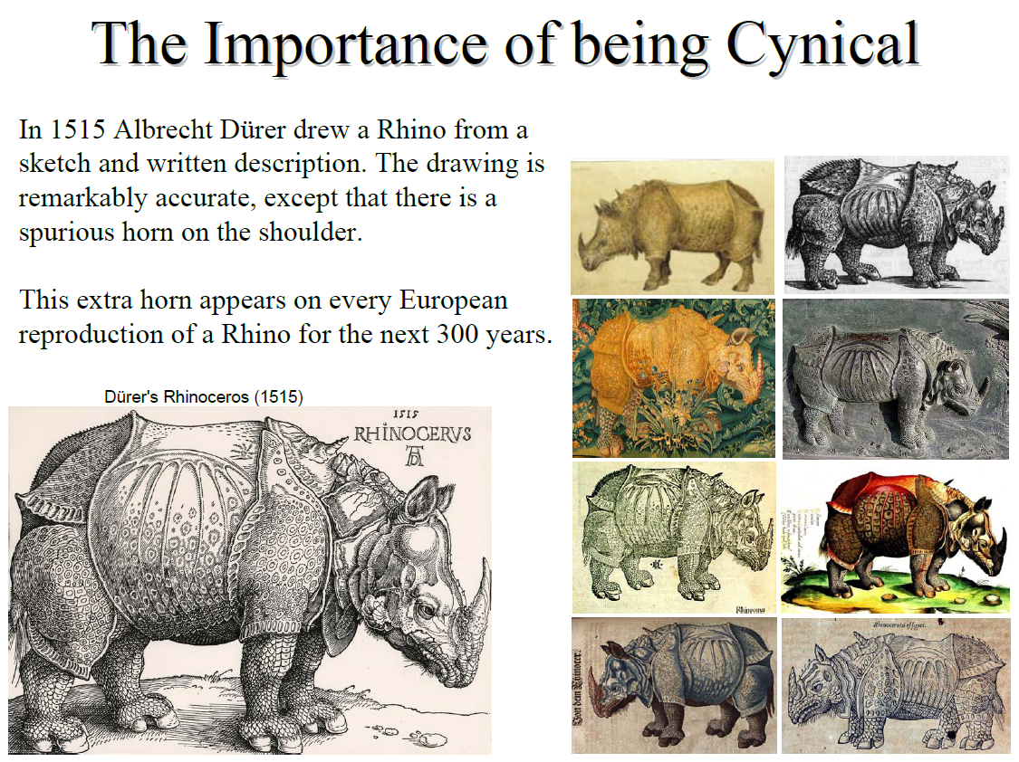
Notes:
E.g., reference to a technical report that doesn’t even exist …

Slide 46
How complex you approach should be
Avoid unjustified complex solutions
Simplicity is a strength, not a weakness, acknowledge it and claim it as an advantage
“This is the simplest way to get results this good”.
Justify the complexity of your approach

Slide 47
Problem solving
Understand the state of the art (learning to read scientific literature)
  This will help you to avoid reinventing a wheel (or you will reinvent less wheels)
Problem Relaxation:
  If there is a problem you can't solve, then there is an easier problem you can solve: find it.
  http://en.wikipedia.org/wiki/How_to_Solve_It
Looking to other Fields for Solutions:
  Can you find a problem related to yours that has been solved and use it to solve your problem?

Slide 48
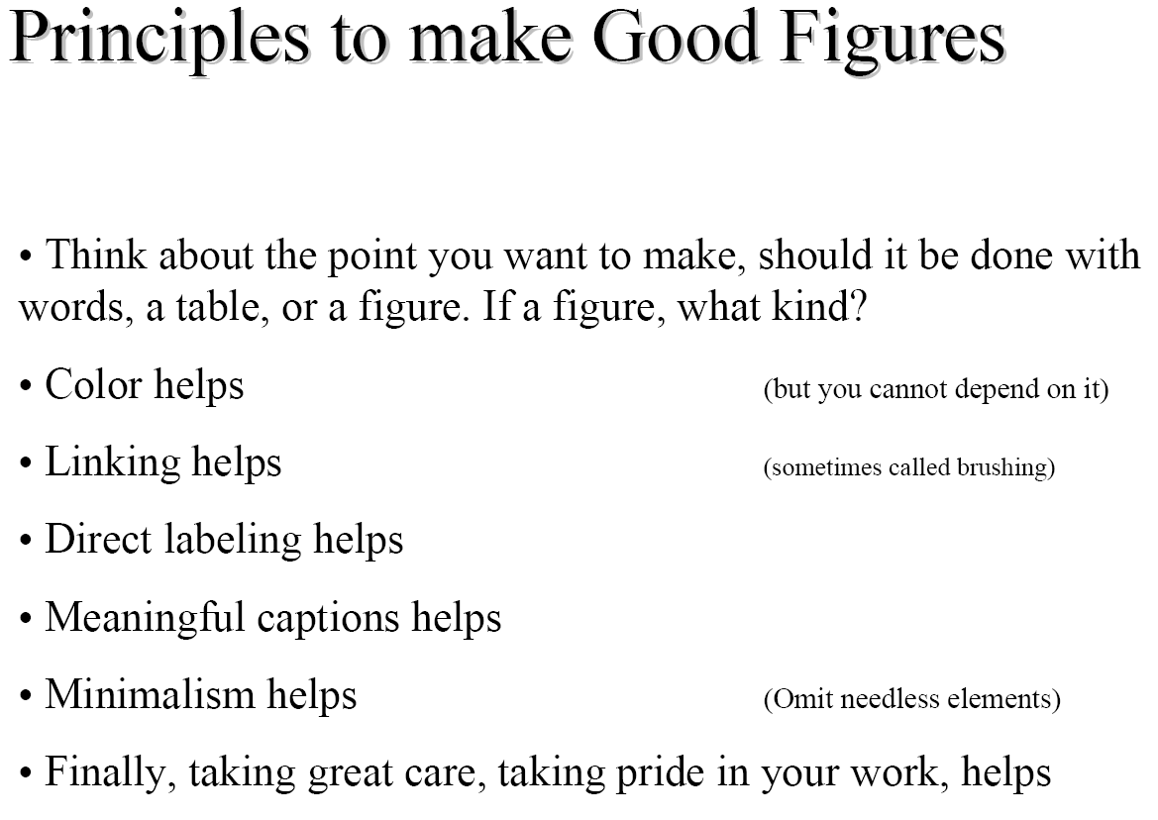

Slide 49
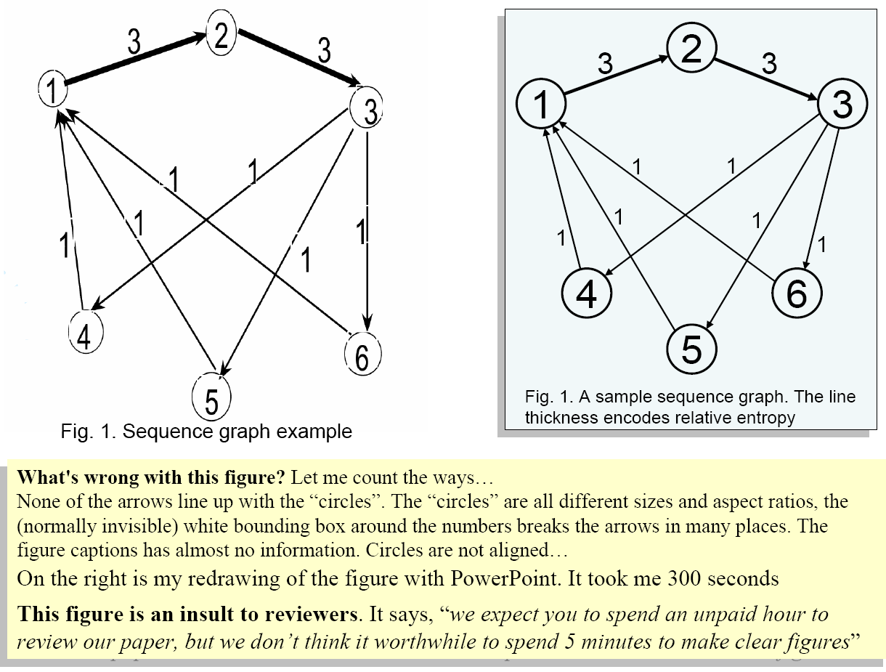

Slide 50
Most common problems with figures
1. Too many patterns on bars
2. Use of both different symbols and different lines
3. Too many shades of gray on bars
4. Lines too thin (or thick)
5. Use of three-dimensional bars for only two variables
6. Lettering too small and font difficult to read
7. Symbols too small or difficult to distinguish
8. Redundant title printed on graph
9. Use of gray symbols or lines
10.Key outside the graph
11.Unnecessary numbers in the axis
12.Multiple colors map to the same shade of gray
13.Unnecessary shading in background
14.Using bitmap graphics (instead of vector graphics)
15.General carelessness
Eileen K Schofield: Quality of Graphs in Scientific Journals: An Exploratory Study. Science Editor, 25 (2), 39-41
Eamonn Keogh: My Pet Peeves

Slide 51
Maintain a critical attitude to what you do and what you write
“To catch a thief, you must think like a thief”
To convince a reviewer/evaluator/reader, you must think like a reviewer
Taking a systematic approach, and being self- critical at every stage will help you chances greatly.
Take pride in your work

Slide 52
Further reading
How to do good research, get it published in SIGKDD and get it cited! Eamonn Keogh
  Start from the slide 67
Herbert A. Simon. The Sciences of the Artificial, MIT Press
Research methods
Should Computer Scientists Experiment More? Walter F. Tichy, 1998
  http://wwwis.win.tue.nl/~gfletcher/2id35-spring13/reading/tichy.pdf
Three traditions of computing, Matti Tedre
  http://dx.doi.org/10.1080/08993400802332332

Slide 53
Questions (to ask yourself)
What are you most concerned/uncertain about with respect to your proposed project?
How do you see your project fitting into the paradigms we’ve discussed above?
Do you have clear metrics of success for your project?
  Or is this part of the process itself?
Does your project have a well defined scope?
  Or is this part of the process itself?

Slide 54
Admin
Remember that the final report (50% of final grade) is due before 23:00 on Sunday 26 January
Remember that final presentations (20% of final grade) will be 29, 30, and 31 January (Wednesday, Thursday, and Friday)
  Times/locations to be announced
  We will use Doodle again

