Slide 1
The future of adaptation (in the on-line world)
Prof. dr. Paul De Bra
Web Engineering Group
Eindhoven University of Technology
Notes:
In this seminar we will have a look at the future of adaptive web-based systems research.
We describe possible projects, within the group and within companies, that together shape parts of that future.

Slide 2
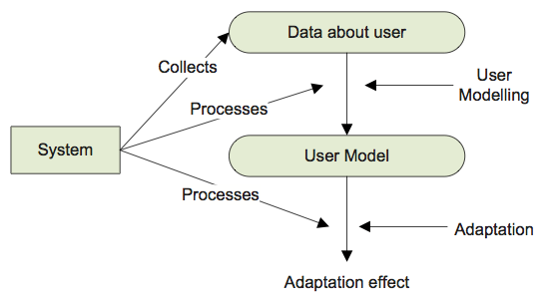
Quick intro about what adaptive systems are…
In the Adaptive Web-Based Systems course we saw this image:
Notes:
Adaptive systems work using a so-called “user-modeling – adaptation” loop.
When a user is working with the system she is generating events that are collected and processed by the system. The events provide data about the user, which includes what the user requested but also some contextual information about time, place, used platform, etc. The small bits of data collected are processed into higher-level meaningful information about the user, which we call a User Model.
Using what we know about the user the request can be answered in a personalized manner. The information requested can be selected, filtered, sorted or processed in any other way to suit the user’s needs. In the case of an adaptive website with links the links embedded in the information or presented separately in a menu can also be filtered, sorted, or annotated in any way, to give the best suggestions to the user. The overall presentation can also be changed, to suit the user’s platform for instance, which can range from a smart watch to a high-resolution monitor.

Slide 3
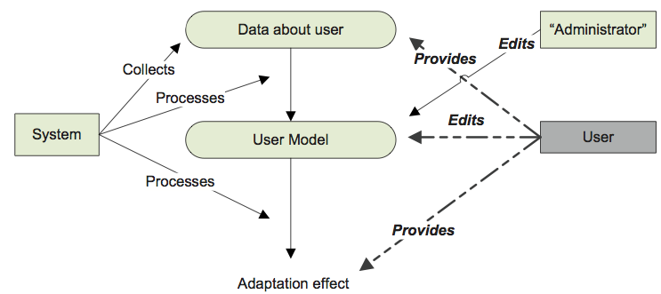
Quick intro about what adaptive systems are…
In the Adaptive Web-Based Systems course we saw this image:
Notes:
We also saw this picture, showing that both the end-user and an administrator may intervene in the user modeling and the adaptation process.
The ability to inspect what the system stores about the user, in raw data, in higher level data, and how that is used for adaptation, is called “scrutability” and is a requirement for trustworthy adaptive systems.

Slide 4
Challenges in Adaptive Web-Based Systems
making it possible for a non-technical person to create adaptive applications
providing user model and adaptation scrutability
(to end-users)
providing control over user model sharing as needed for collaborative filtering
within-browser adaptation: move adaptation from server side to client-side
creating analytics tools that help authors/designers to improve their adaptive applications
meta-adaptation: analytics results going directly to the system rather than to an author
making websites adaptive instead of making adaptive websites
Notes:
In this seminar we are going to look at some challenges in adaptive web-based systems, each of which can be the subject of one or even more master projects.
On the following slides each of these challenges will be explained in detail, including what can be done as a preparatory work for this seminar.

Slide 5
authoring by non-technical people
use a “standard” environment like Microsoft Word
  this leads to mixing content and adaptation
    outcome concepts
    background concepts
  content creation is “familiar” to many people
Notes:
We look at a few ways in which authoring can be done.
The authoring for Interbook involves writing an “annotated” MS Word file.
On the one hand this is easy for people who are familiar with MS Word but it does involve writing adaptation “rules”. In Interbook this means defining outcome concepts about which the following “part” generates knowledge, and background concepts which need to be known in order for the following “part” to be recommended (i.e. prerequisites).

Slide 6
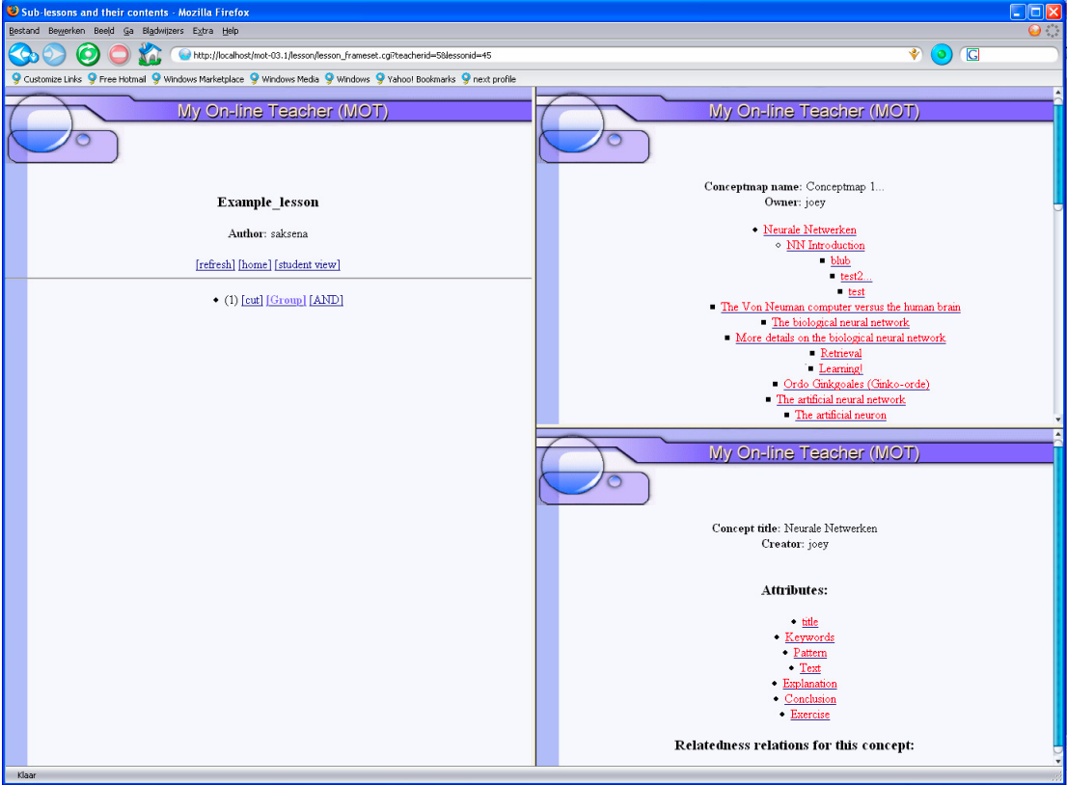
authoring by non-technical people
use a special-purpose environment, e.g. MOT by Cristea et al.
  embeds “intelligence” in conceptual model
  steep learning curve
Notes:
An example of a completely special-purpose adaptive hypermedia authoring tool is MOT, developed by Alexandra Cristea and her group.
An author has to define a concept map, attributes, rules, and content all within one specialized authoring environment.
Look at http://prolearn.dcs.warwick.ac.uk/MOT/Mot_Usage.pdf for a complete description of how to use this tool.
The resulting application is special purpose, like the authoring environment.

Slide 7
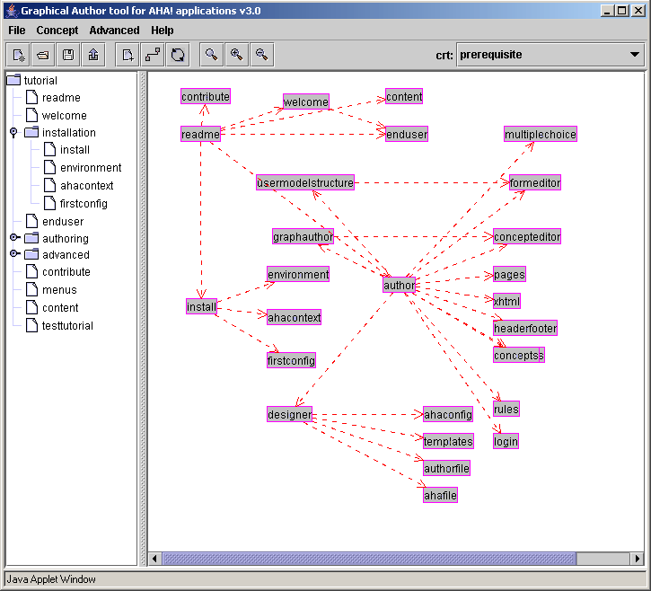
authoring by non-technical people
use a graphical environment for model & adaptation
  AHA! (graph author), GALE (GAT tool)
  content is (almost) “standard” html
  partial or full separation of content and adaptation
Notes:
In AHA! and later GALE a graphical and simple to use tool is used to create the conceptual structure and to draw concept-relationships.
Non-technical authors only need to use the graphical tool, whereas technical authors can create their own templates for new adaptation rules.
The image shows the AHA! graph author tool. It is easier to use than the GAT authoring environment developed in the GRAPPLE project.

Slide 8
Assignment: compare authoring tools
Google for authoring adaptive hypermedia
  look for authoring papers using integrated, partly separated and completely separated authoring of content versus models and adaptation
  make a comparison of usability of authoring through these different approaches
  sketch a design for an “ideal” authoring environment, e.g. for creating adaptive courses, an adaptive encyclopedia, or an adaptive shop
  (for info on AHA! see aha.win.tue.nl)
  (for info on GALE see gale.win.tue.nl)
  This assignment may lead to an authoring master project together with a company (e.g. De Roode Kikker)

Slide 9
scrutability = designed to allow to scrutinize
bad example: the “status” plugin in GALE
  #suitability -> true #link.iconlist -> null
  #new-content -> false #hierarchy -> true
  #tags -> default #known-all -> false
  #link.hide -> !${#hierarchy} #known -> true
  #layout.css -> http://localhost:8080/awbs/menu.css;http://localhost:8080/awbs/awbs.css
  #available -> true #show-image -> false
  #visited -> 5 #unknown -> false
  #own-knowledge -> 1.0
  #link.classexpr -> ~ if (${#unknown}) return "unknown"; if (!${#suitability}) return "bad"; if (${#visited}==0) return "good"; if (${#new-content}) return "new"; return "neutral";
  #new-session -> false
  #tags.class -> ~ if (!gale.isObject() && "long".equals(element.attributeValue("tag"))) return "th-sidenote"; return null;
  #layout.title -> ${.}.getTitle() #knowledge -> 0.47777777777777775
  #resource -> http://localhost:8080/awbs/layout.xhtml
Notes:
Scrutability is a non-existent English word. To scrutinize means to be allowed to inspect in detail, and in adaptive systems we also include the ability to correct after inspection.
In order to be able to scrutinize information from an adaptive system it is important that this information is presented in a way the end-user can understand. In the GALE system the “status” plugin allows you to inspect the user model data associated with a certain concept. This results in the information that is displayed on the slide. Needless to say this is hard for an end-user to understand.
Scrutability is concerned with providing users insight into their user model and this is more than displaying some raw user model data.

Slide 10
(research) issues in scrutability
selecting meaningful data (user model attributes)
  e.g. from the example: own-knowledge (stored), knowledge (not stored but computed), suitability
visualization of these data
  show domain model graphically
  zoom in/out to show user model information
allow selected updates/corrections
  e.g. correct preferences and background knowledge
  e.g. not allow updates of knowledge

Slide 11
Assignment: compile state-of-the-art overview
Google for user model scrutability
  look for papers about scrutability: selection, presentation, updates
  make a comparison of different approaches you find
  sketch a design for an “ideal” scrutability extension for our GALE system
  (for info on GALE see gale.win.tue.nl)
  This assignment may lead to a master project about learning analytics dashboards

Slide 12
user model sharing (users and applications)
Many adaptive systems disallow user model sharing
  but sharing profiles between different applications is interesting (and allowed but still experimental)
Collaborative filtering requires user model sharing
  here sharing of user models of different users is needed
A generic user modeling platform must be capable of both sharing between applications and between users
  example: GUMF, developed in the GRAPPLE project
  (build on GUMO, and later developed into Mypes)
  other research e.g. by Kuflik
Notes:
A good first paper to read is http://ceur-ws.org/Vol-872/aum2012_paper_2.pdf by Dim and Kuflik, and then go from there following references.

Slide 13
Assignment: compile state-of-the-art overview
Google for user model sharing
  look for papers about user model sharing (both between applications and between users)
  also look for papers about collaborative filtering
  make a comparison of different approaches you find
  sketch how the two types of user model sharing could be added to the GALE system, while keeping control over privacy and security issues.
  (for info on GALE see gale.win.tue.nl)
  This assignment may lead to a master project working on user model sharing for GALE

Slide 14
within-browser adaptation
Current architecture:
  client sends request
  server updates user model
  server adaptively selects resources
  server updates resources
  server sends result to the client
New architecture:
  client sends request
  client also updates local user model
  server adaptively selects resources and adaptation code and sends the result to the client
  client adapts resources using the code
Notes:
In current adaptive web-based systems the user modeling and adaptation are all performed on the server side. The client (browser) is used as a dumb device capable of presenting information and sending events to the server.

Slide 15
Assignment: study of the possibilities
This is work with Alejandro Montes-Garcia
Try to answer the following questions:
  what are the possibilities of “local storage” for client-side user modeling?
  how would a “slider” to gradually move between client-side and server-side user modeling work?
  how can a client prevent adaptation code from stealing local user model data?
  how can a client mask user model data from being discovered by monitoring just the requests?
  any other question you come up with yourself…
This assignment may lead to a master project in the context of the WiBAF Impulse project

Slide 16
web analytics tools for application designers
Question: “How is my adaptive site being used?”
Underlying question: “Is my design any good?”
Example: the hypermedia course (2ID65)
  Three forms of adaptation:
    content adaptation: conditional inclusion of fragments
    link adaptation: link annotation through link colors:
    good, neutral or bad
    layout adaptation: navigation menu appears only after the first three chapters have been studied
  Adaptation based on:
    prerequisites: what have you read before?
    tests: have you taken the test of certain chapters?
Notes:
We did evaluation of the effect of adaptation on the hypermedia course 2ID65 offered at the TU/e to students in computer science and innovation science.
This course is about hypermedia and is given entirely on-line through the use of adaptive hypermedia.
The course uses three types of adaptation:
There are a few places where prerequisite explanations are inserted in a page when needed (using the conditional inclusion of fragments technique). If a user later revisits the same page but no longer needs the explanation it is not shown, so the page actually looks different. We consider it a “success” if learners never notice such changes and so far they have not noticed anything. We do not consider this content adaptation further in this seminar.
Link adaptation is done by means of the color of the link anchors. We use a technique called link hiding: non-recommended links have a black link anchor that is not underlined, and because the normal text is black as well the link is not visible. (But when you mouse over it the cursor does change and when you click on the link it does work.) Recommended links have the traditional blue/purple web color scheme for unvisited and visited links.
We also perform layout adaptation: the course starts with a layout that does not contain a navigation menu. Later that menu is added (after studying the first three chapters). The menu is initially not shown to give the learner more of a “real hypertext” feel where you can only navigate by following links within pages. We will not consider this layout adaptation further in the seminar.
The adaptation in the course is based on prerequisites. Typically the prerequisites consider what you read before, but in some cases the adaptation is based on having taken some tests that appear in the course. The prerequisites only influence the layout adaptation and the link annotation. The availability of links is not altered (only the visibility).

Slide 17
When adaptation fails…
Example: the 2ID65 course was served through AHA!, the Adaptive Hypermedia Architecture (Open Source, from TU/e)
Data log analysis:
  Logs were used from the course offering in 2007/2008;
  We used 76 out of 127 students (76 with sufficiently complete records)
  We used 34.850 (from the total of 62.993) log entries
Logs were used to find out whether students followed the link annotation “advice”
Notes:
For our experiment to decide whether adaptation matters we analyzed the logs of two years worth of logs of the hypermedia course.
This course is served through AHA!, the open source Adaptive Hypermedia Architecture, developed partly with a grant from the NLnet Foundation through the Adaptive Hypermedia for All project.
The course does attract visitors, named or anonymous, who study part of the course but do not complete it. We decided not to use visitor data but used only the log information from 76 students who completed most or all of the course. This resulted in 34.850 usable log entries.
We created a slightly modified version of AHA! where a log could be re-run. By re-running the entire process followed by a student we could analyze for each access what the status of the link annotations was the user saw at the time. So for every page the user visited we could “see” how many links were presented on that page, how many of them were “good”, “neutral” or “bad”. in particular we could also see whether the next page visited was reached through following a “good”, “neutral” or “bad” link.

Slide 18
Observations of link annotation
Roughly 20% of BAD access
Notes:
This graph shows the twelve chapters of the course (actually the starting page for each of these chapters).
For each chapter the green bar represents the number of accesses using good or neutral links and the red bar represents the number of accesses using bad links. For the chapters “intro”, “definition” and “history” there are no prerequisites so there are never bad links to these chapters (hence no red bar).
The differences in size for the green bars is not important as a chapter may get a lot of revisits as a gateway to the underlying pages. What is important is to note the red bars, indicating cases where hiding the bad links has not worked.
The most striking red bar is that for the topic of adaptive hypermedia. About 20% of the accesses to this topic goes through bad links.
So we should investigate what causes this.

Slide 19
Empirical analysis
Adaptive Hypermedia Concept
  30% of the students accessed via bad links
  Students also followed subconcepts via bad links
  Largest in-degree for non-recommended concept and 5th largest in-degree overall
    Concepts that are mentioned often appear to invite users to visit them, despite not being recommended
Other concepts (together) averaged 1.5 access per student via bad links
  Students mostly follow the adaptation rules
  The adaptive engine had success guiding them through the links of the course.
Notes:
For the most part students seemed to follow the guidance offered through link annotation/hiding.
But the accesses to some concepts through bad links is remarkable, especially for the adaptive hypermedia concept: 30% of the students accessed this concept at least once through a bad link. For other concepts this was lower but also not zero.
Further analysis has revealed that students also study subconcepts of adaptive hypermedia through bad links.
Note that the bad links exist only while the students do not see a navigation menu, so they really followed bad links that appear within the text of the pages.
So why did the students follow bad links to concepts?
In the case of the AdaptiveHypermedia concept, we found that this concept has the fifth-largest in-degree of the whole course and the largest in-degree for non-recommended concepts.
Even though this concept is non-recommended at the beginning of the course there are several references to this concept in the introductory pages.

Slide 20
What to do when adaptation fails?
Example: frequent non-recommended links are followed:
  change the recommendation?
  remove the links?
Problem is that adaptation rules are fixed:
  this is like the behavior of a new teacher
  (has learned how to adapt to students and will follow these rules religiously)
How can we adapt the adaptation rules?
  first: how can we make adaptation rules adaptable?
  then: how can we use that adaptation?
Notes:
What can we do when the adaptation fails. In the course 2ID65 we see that non-recommended links are followed and we think this is because these links appear often.
We don’t want non-recommended links to be followed. (There is a reason why they are not recommended.) So how can this be solved?
Recommending the links anyway is not a good solution because there is a reason why the links are not recommended. Recommending the links after changing the content of the link destination is a possibility but this cannot be automated.
Removing the links is not a good solution because the links appear in the text so the text continues to suggest the link destination. Removing the links will frustrate the user.
The conditions under which links are presented are fixed inside adaptation rules. This is like the behavior of a new teacher or any newly trained person: they apply what they learned and are not yet open to trying new strategies that go against what they learned.
How can we fix this? We must make adaptation rules adaptable through some type of “parameters” and then we need to learn how to use these parameters.

Slide 21
Assignment: how to evaluate adaptive applic.
Google for “adaptive hypermedia evaluation”
  Study articles on evaluation
  Judge whether articles do a scientifically correct evaluation or not
  Design a framework for performing evaluation of adaptive applications in general
  Sketch how this could be applied to courses served by GALE for instance
This assignment may lead to a master project on web analytics and/or learning analytics

Slide 22
meta-adaptation (adaptation of the adaptation)
Adaptation follows “fixed” adaptation rules
What if these adaptation rules lead to suboptimal adaptation?
  how to decide whether adaptation is not optimal?
  how to change the adaptation by:
    changing parameters?
    adding/removing adaptation rules?
  how to enable an adaptation rule to change another adaptation rule in general?
  how to change the GALE architecture to allow for meta-adaptation?

Slide 23
Assignment: feasibility of meta-adaptation
Google for meta-adaptation
  You may not find many relevant results…
  Try to answer the meta-adaptation questions
  Sketch how meta-adaptation can be made to work in GALE
  This may lead to a master project on realizing meta-adaptation in GALE (to a limited extent)

Slide 24
making websites adaptive
Assignment: can we do this with GALE?
  Study the GALE configuration… to eliminate the use of the GALE name space
  How can we do adaptation to “real” HTML tags?
  Can you make use of “id’s” in the adaptation?
  Develop a small application to demonstrate the adaptation to a website that has no built-in GALE dependencies.
  This may lead to a master project in the WiBAF context.

Slide 25
making websites adaptive (cont.)
How can we make existing websites adaptive without changing them?
  short answer: we cannot
  long answer:
    we need to insert code in the webpages, either directly or through a proxy
    the code can adapt the DOM tree
  longer answer:
    to adapt the page code needs to be able to identify each element on the page
    this requires that the webpages are designed with this identification in mind
    software that generates webpages tends to do this

